Slide 1
Introduction
Digitizing handwritten whiteboard notes is crucial for students, educators, and remote workers
Manual capturing often results in angle distortions, blur, and poor quality images.
Automating whiteboard detection and cropping can simplify note digitization.
our project aims to build a user-friendly interface that extracts clean images even under challenging conditions.
Problem Statement
Traditional whiteboard photos often suffer from perspective distortion, noise, artifacts, and inconsistent illumination. Existing manual cropping and enhancement techniques are time-consuming and error-prone. Automated solutions using computer vision can detect the whiteboard region, correct the image perspective, remove artifacts, and enhance visual quality to make content more readable and digitally accessible.

Slide 2
Literature Review & Problem Statement
Existing tools like CamScanner work well for flat documents but fail on angled or reflective whiteboards.
Reflections, smudges, and irregular edges reduce text clarity.
No adaptive image enhancement based on lighting or blur.
Conventional apps struggle to detect and crop whiteboard boundaries.
Students find it difficult to capture clear notes from whiteboards.
Need for an automated system that detects, enhances, and extracts handwritten text accurately.

Slide 3
Objectives & Scope
Objectives:
Automatically detect whiteboards and correct perspective distortion
Enhance image readability by increasing contrast by at least 30% using CLAHE and thresholding.
Achieve whiteboard region detection accuracy of at least 90% on a varied image dataset.
Provide three quality modes: High Quality PNG, Web Optimized, and Original Size
Build an intuitive Streamlit interface for upload, preview, and download
Scope: Focused on still whiteboard images. Future extensions may include OCR-based text extraction and cloud-based access.

Slide 4
Methodology & System design
Image Upload-User selects and uploads a whiteboard image via the Streamlit web interface.
Preprocessing-The image is converted to grayscale, enhanced with CLAHE for contrast, and denoised with filtering techniques.
Whiteboard Detection-Automatic contour detection and cropping isolate the whiteboard region for focused processing.
Image Enhancement-Adaptive thresholding and normalization are applied for clean, sharp text extraction.
OCR Extraction-The enhanced image is analyzed by EasyOCR to extract textual content accurately, including handwritten notes.
User Output-The processed image and extracted text are displayed for user review, copying, or download.

Slide 5
Tools and Technologies Used
Programming Language: Python
Libraries: OpenCV, NumPy, PIL (Pillow), EasyOCR
Web Application Framework: Streamlit
Algorithms and Techniques: Laplacian Variance, CLAHE, Otsu Thresholding, Gaussian Filtering

Slide 6
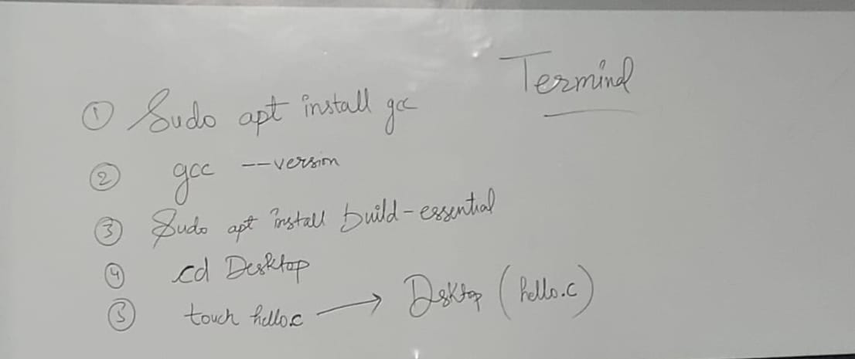
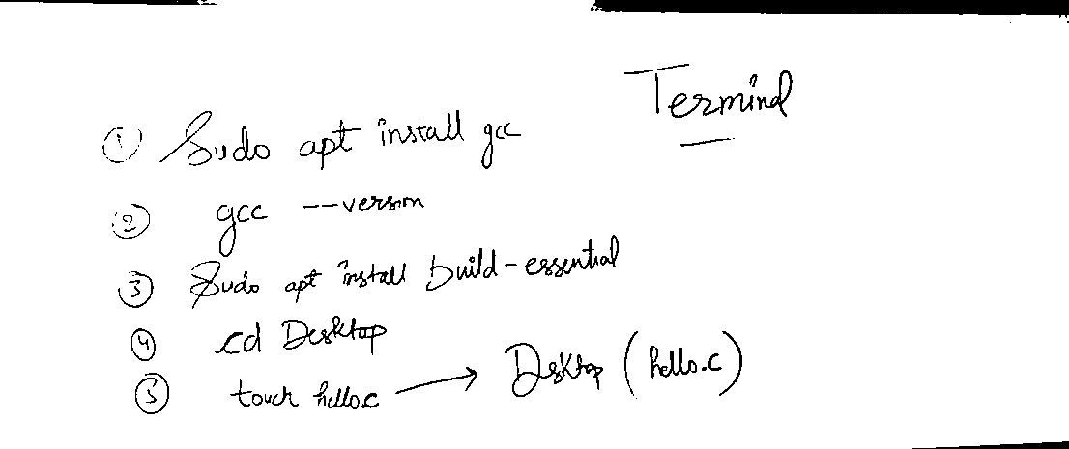
Results and Discussion
Previous Result
Before After

Slide 7
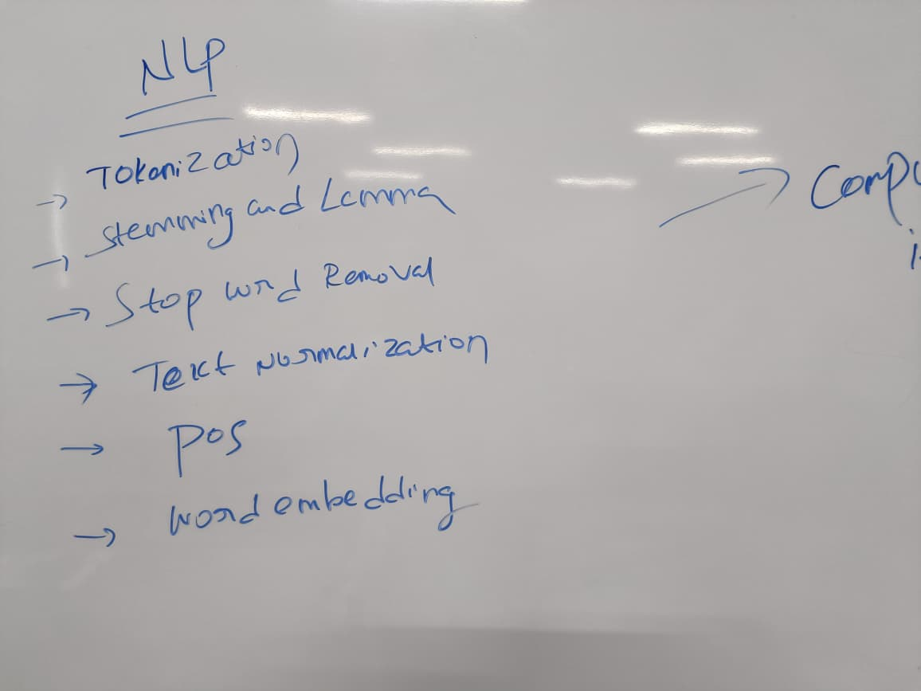
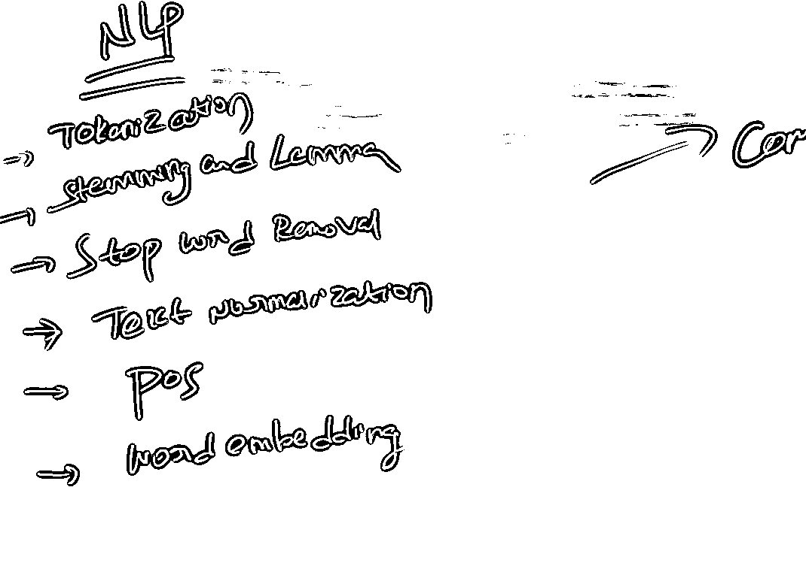
New Result
Before After

Slide 8
Innovation / Unique Contribution
Adaptive Enhancement Based on Blur Score: Dynamic selection of enhancement algorithm ensures consistent clarity.
Integrated OCR Extraction: Uses Easy-OCR to instantly convert handwritten/marker text to editable text.
Triple-Threshold Edge Detection: Improves contour detection in variable lighting.
Transparent Processing Display: Shows blur score, enhancement method, and recognized text in real time.
User-Friendly Interface: Simple upload–process–download flow with live preview.

Slide 9
Conclusion & Future Scope
Conclusion: The Whiteboard Auto-Cropper with OCR and Blur Detection successfully automates the entire process of:
Detecting and correcting perspective of whiteboards
Enhancing visibility using adaptive algorithms
Extracting readable text through OCR
Future Scope:
Handwriting Recognition Improvements
Integrate advanced deep learning OCR models to increase handwritten and multilingual text accuracy.
Mobile App Integration
Develop Android/iOS apps with the same enhancement and text extraction features for easy classroom or field usage.

Slide 10
References:-
Archana, R., Jeevaraj, P.S.E. Deep learning models for digital image processing: a review. Artif Intell Rev 57, 11 (2024)
Yadav, S.P., Jindal, M., Rani, P. et al. An improved deep learning-based optimal object detection system from images. Multimed Tools Appl 83, 30045–30072 (2024).
Whiteboards Detection Computer Vision Model
Deep Learning based Automated Image

